Slide 1

Machine Learning Supervised Algorithms
Presented By
Sathish Kumar Venugopal Jan’2020

Slide 2
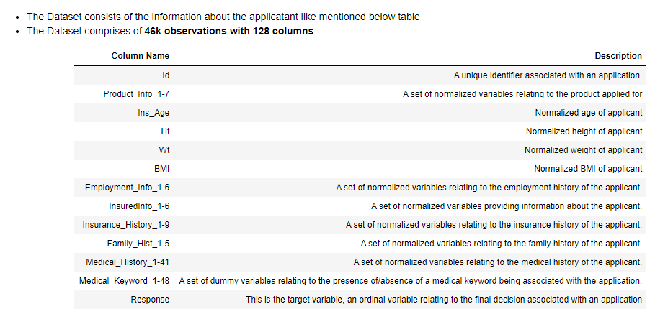
Insurance Data Set

Slide 3
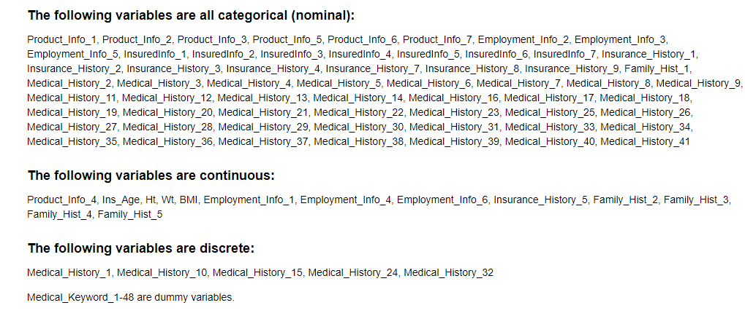
Insurance Data Set

Slide 4
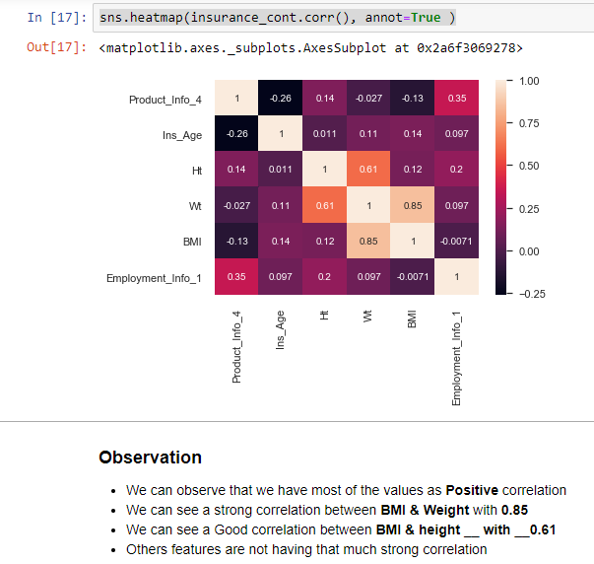
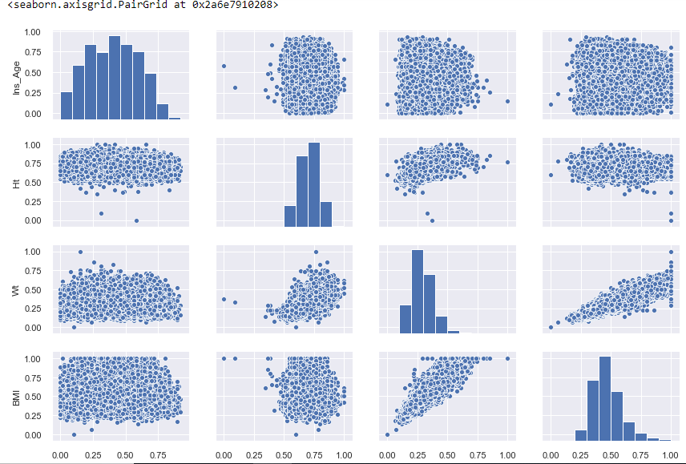
EDA
Correlation
Pair Plot

Slide 5
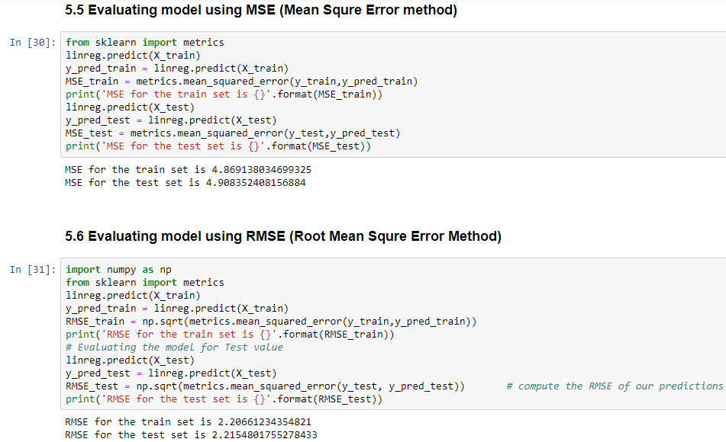

Linear Regression

Slide 6

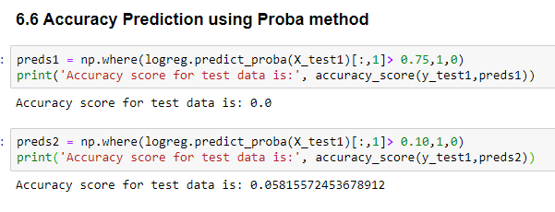

Logistic Regression

Slide 7


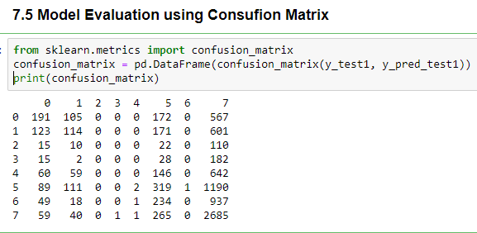

DecisionTree

Slide 8

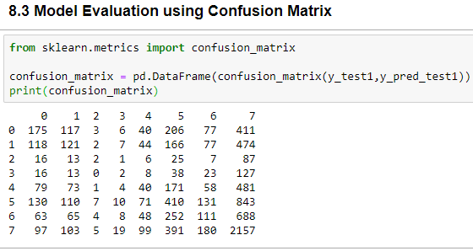


RandomForest

Slide 9

Final Summary

